Slide 1
Micflix
Sprint: 2
A netflix clone - by Mickey Krekels
Class: RB04

Slide 2
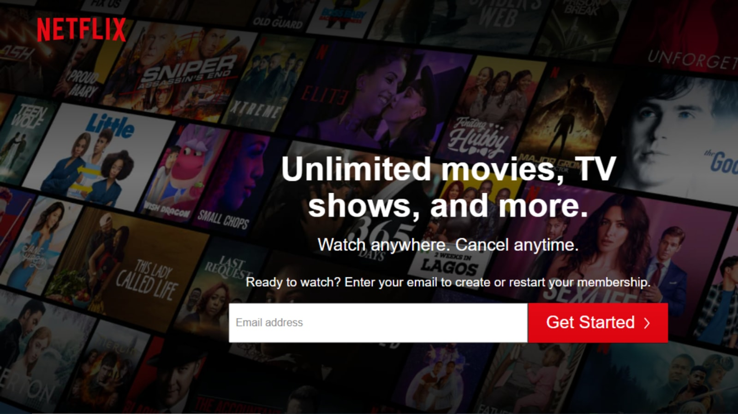
Introduction
Sprint goal
Achievements
Foundation Topics
Enterprise Architecture & Software Platforms
Architecture & Quality
Messaging & Security-by-Design
DevSecOps & Cloud Services
Roadmap
Next steps

Slide 3
Sprint goal
The main goal of sprint 2 was to set up a walking skeleton with the all of the basic features.
The issues/stories created for the sprint were:
Create a user-service in golang
Create a movie-service in golang
Create a movie-management-service in golang
Create a front-end dashboard page
Create a front-end watch page
Use Keycloak to authenticate the angular client
Create a stack with a docker-compose file to connect the containers

Slide 4
ACHIEVEMENTS
User-service online
Movie-service online
Movie-management-service online
Streaming-platform online
Authentication with Keycloak
RabbitMQ Message broker
Walking skeleton [demo]

Slide 5
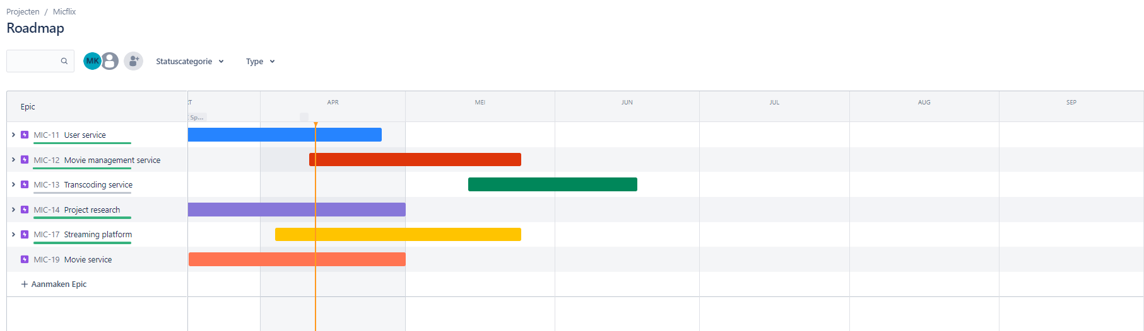
Enterprise Architecture & Software Platforms
Jira
Notes:
Enterprise applications (EA) are applications that are used in an enterprise context and are mainly used to satisfy the information management needs of an organization rather than individual users.

Slide 6
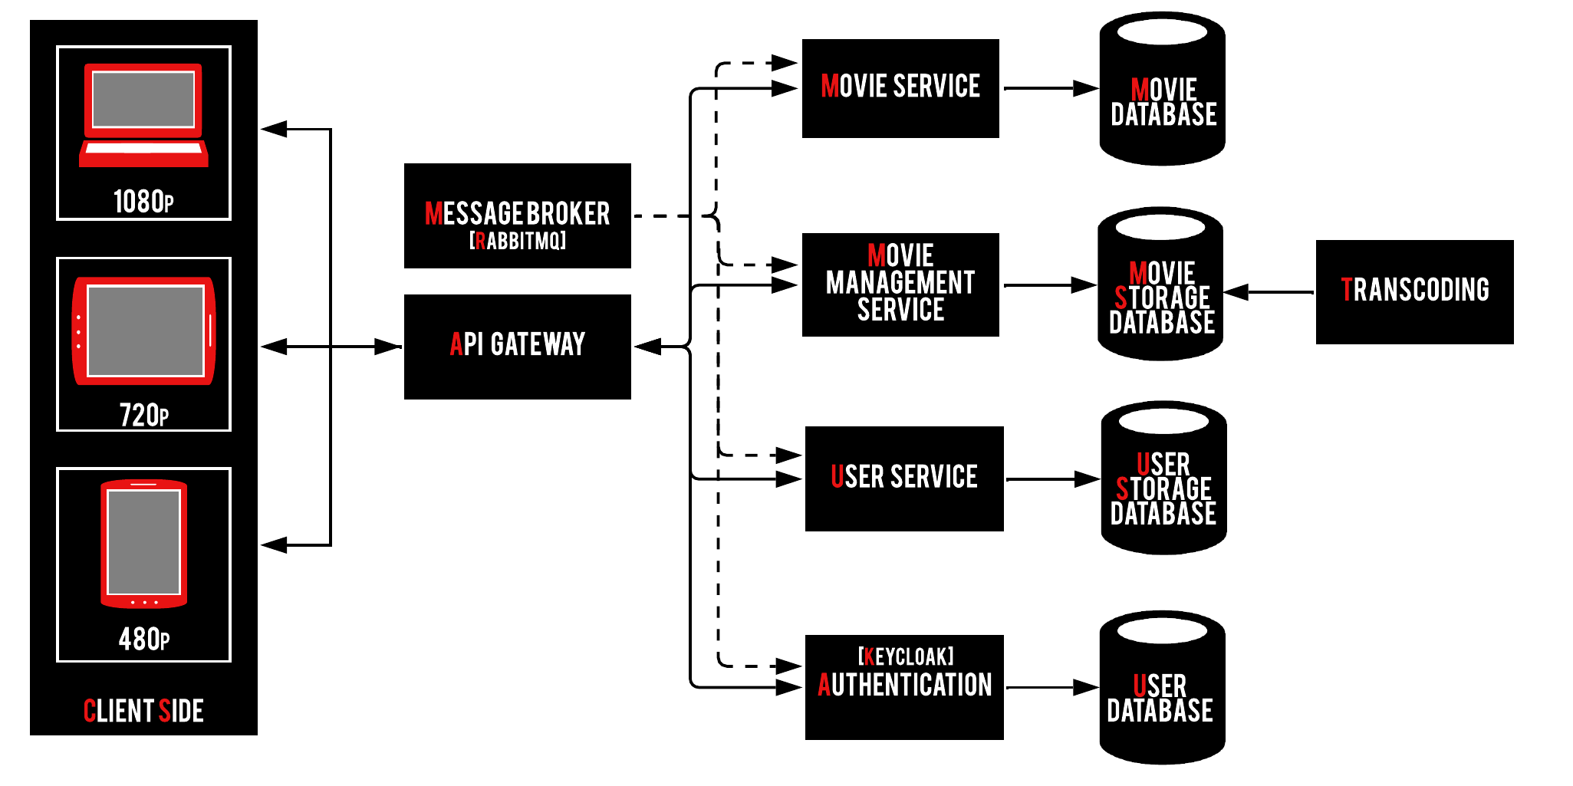
Architecture & Quality
Improved the C2 model

Slide 7
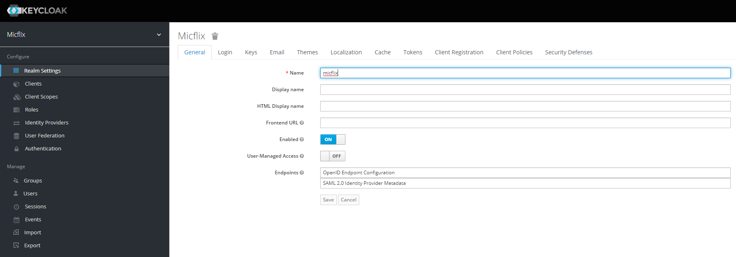
Messaging & Security-by-Design
Authentication with Keycloak
RabbitMQ Message broker

Slide 8
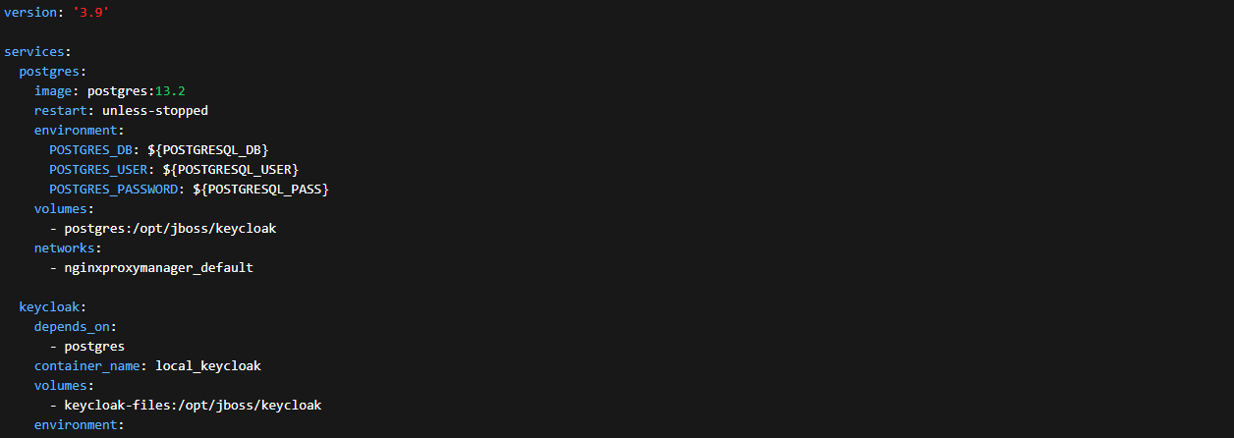
DevSecOps & Cloud Services
Named volumes for persistent data
Grafana for monitoring
The usage of docker Compose files

Slide 9
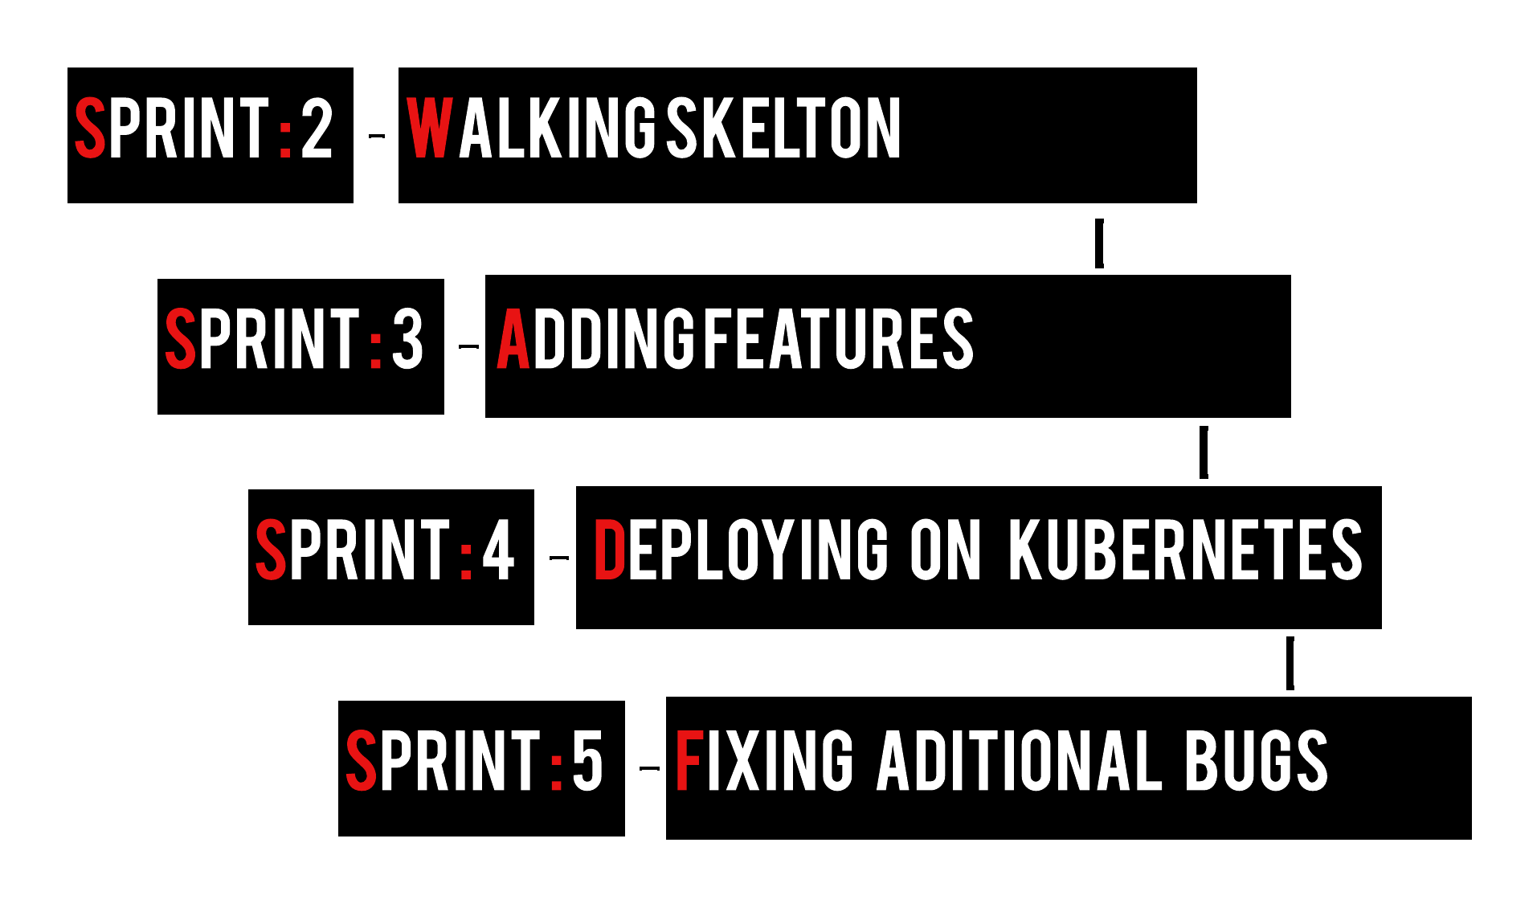
Roadmap

Slide 10
Next steps
Focusing on Adding Features
Creating a kubernetes environment locally
Working on the DevOps document

